Slide 1
Physics Informed Neural Networks (PINNs)
Paht Juangphanich, Ezra McNichols, Kyle Monaghan, Arman Mirashemi

Slide 2

Timeline
1990s: Proof was made to show Neural Networks can be used to solve PDEs
Lagaris, I. E., Likas, A., & Fotiadis, D. I. (1998). Artificial neural networks for solving ordinary and partial differential equations. IEEE transactions on neural networks, 9(5), 987-1000.
1998-2019: Conventional PINNs, solving PDE without discontinuity
2019-Present: Research into solving discontinuous PDEs
Michoski, C., Milosavljević, M., Oliver, T., & Hatch, D. R. (2020). Solving differential equations using deep neural networks. Neurocomputing, 399, 193-212.
Patel, R. G., Manickam, I., Trask, N. A., Wood, M. A., Lee, M., Tomas, I., & Cyr, E. C. (2022). Thermodynamically consistent physics-informed neural networks for hyperbolic systems. Journal of Computational Physics, 449, 110754.
Papados, A. Solving Hydrodynamic Shock-Tube Problems Using Weighted Physics-Informed Neural Networks with Domain Extension.

Slide 3
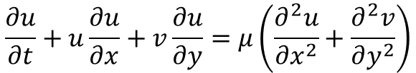
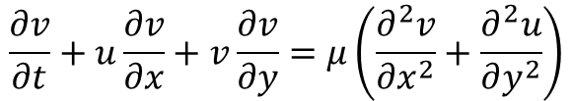
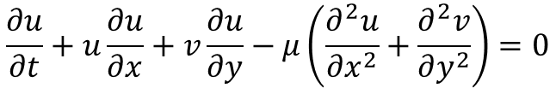
Conventional PINNs and how they work (High Level)
Example 2D Burgers Viscous Equation:
$$\frac{∂u}{∂t}+u\frac{∂u}{∂x}+v\frac{∂u}{∂y}=μ\left(\frac{∂^{2}u}{∂x^{2}}+\frac{∂^{2}v}{∂y^{2}}\right)$$
$$\frac{∂v}{∂t}+u\frac{∂v}{∂x}+v\frac{∂v}{∂y}=μ\left(\frac{∂^{2}v}{∂x^{2}}+\frac{∂^{2}u}{∂y^{2}}\right)$$
Dissipation
Y
Multi-Layer Perception
$$\frac{∂u}{∂t}+u\frac{∂u}{∂x}+v\frac{∂u}{∂y}−μ\left(\frac{∂^{2}u}{∂x^{2}}+\frac{∂^{2}v}{∂y^{2}}\right)=0$$
X
Model
Inputs: t, x, y
Outputs: u, v
PDE Loss
Domain Sampling
(Inputs: t, x, y)
Optimize Model weights

Slide 4
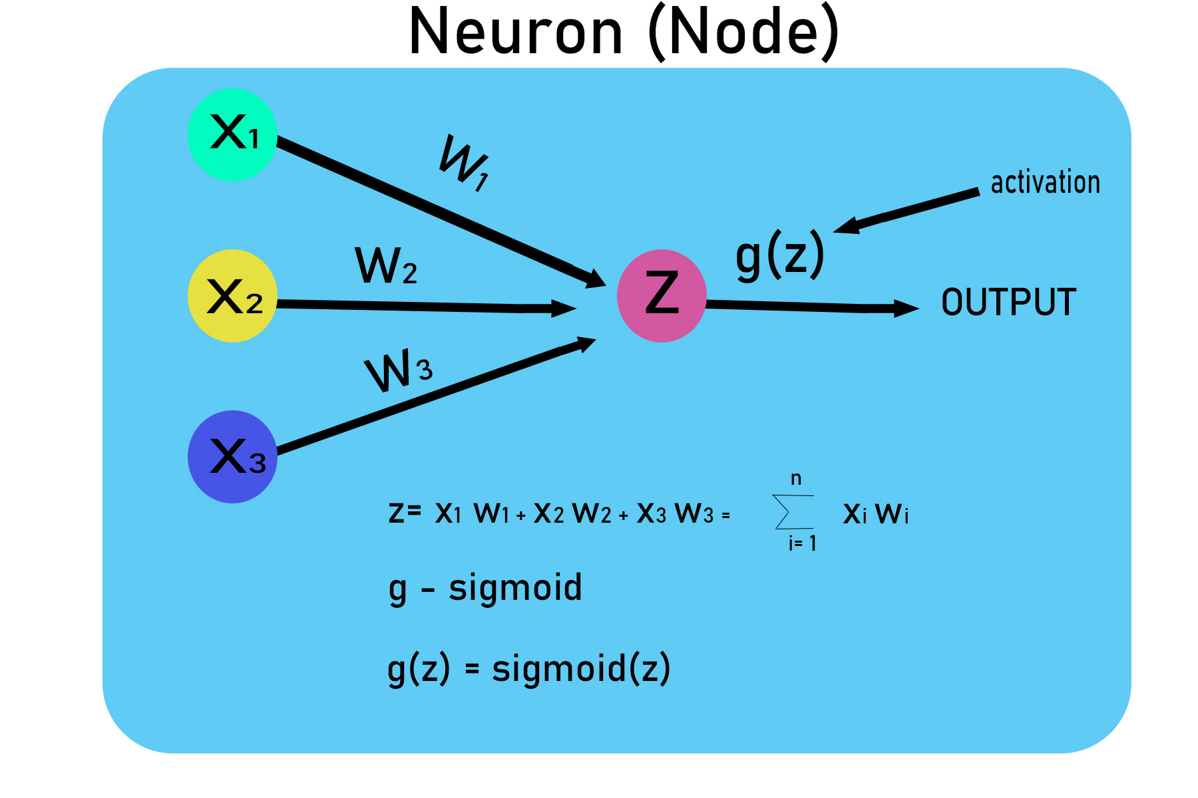
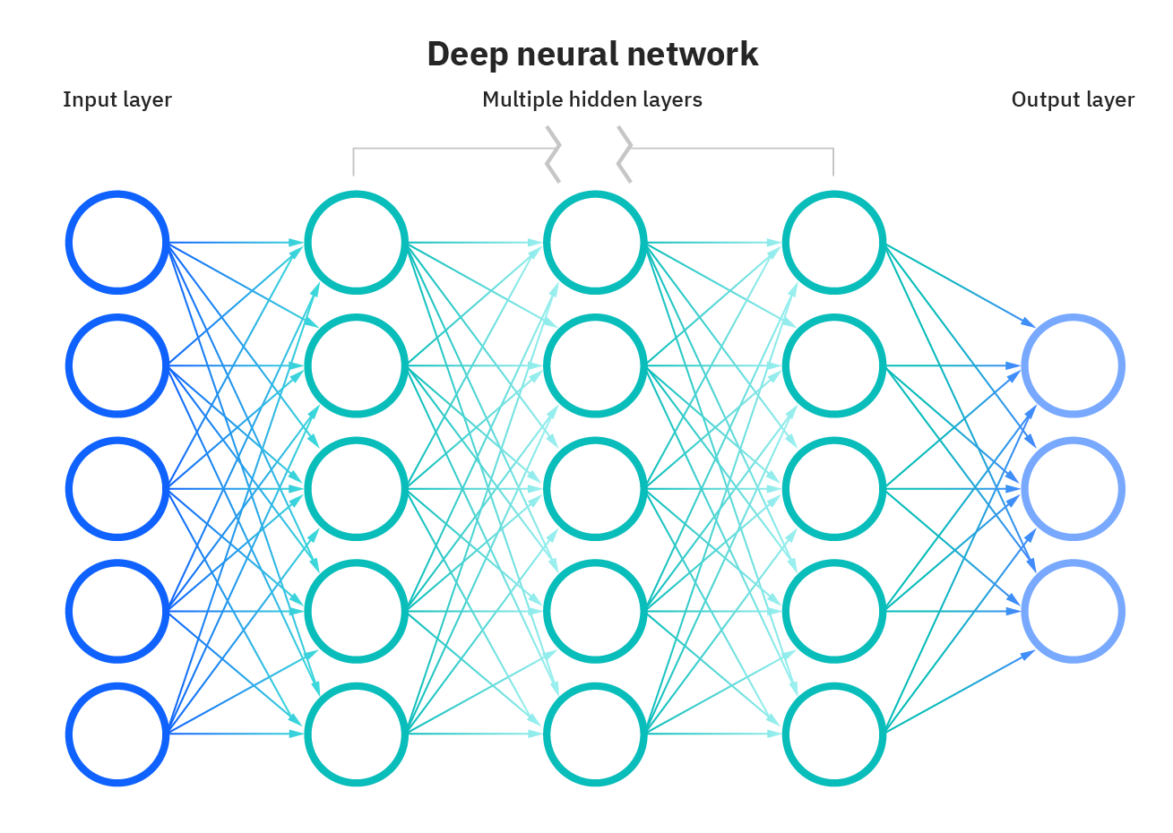
Conventional PINNs and how they work (MLP Detail)
= Tanh(z)
Inputs: x, y, t
Outputs: u, v
Super Important!!!!

Slide 5
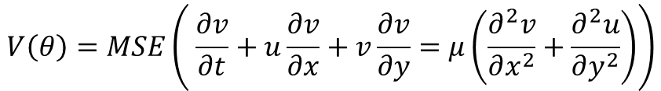
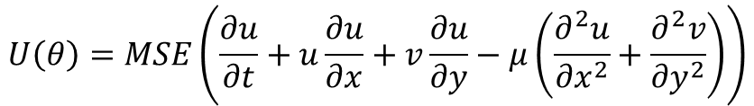


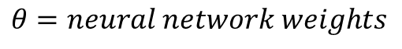
Conventional PINNs and how they work (PDE Loss Detail)
Loss for U and V
Model ($θ$)
u(t,x,y)
t, x, y
v(t,x,y)
$$θ=neural network weights$$
PDE-Loss Function
Derivatives computed using Auto gradient of the model (Remember the tanh(z) ?)
No discretization needed !
$$U\left(θ\right)=MSE\left(\frac{∂u}{∂t}+u\frac{∂u}{∂x}+v\frac{∂u}{∂y}−μ\left(\frac{∂^{2}u}{∂x^{2}}+\frac{∂^{2}v}{∂y^{2}}\right)\right)$$
$$V\left(θ\right)=MSE\left( \frac{∂v}{∂t}+u\frac{∂v}{∂x}+v\frac{∂v}{∂y}=μ\left(\frac{∂^{2}v}{∂x^{2}}+\frac{∂^{2}u}{∂y^{2}}\right)\right)$$
MSE = Mean squared error
Left Wall, Right Wall
$L\left(θ\right)={\left(U\left(θ\right)+V\left(θ\right)\right)}_{ics}+{\left(U\left(θ\right)+V\left(θ\right)\right)}_{Left}$+ ${\left(U\left(θ\right)+V\left(θ\right)\right)}_{Right}$
+ ${\left(U\left(θ\right)+V\left(θ\right)\right)}_{Top}$+ ${\left(U\left(θ\right)+V\left(θ\right)\right)}_{Bottom}+{\left(U\left(θ\right)+V\left(θ\right)\right)}_{Interior}$
Top Wall, Bottom Wall, Interior

Slide 6
Conventional PINNs Solution
PINNs
Analytical

Slide 7
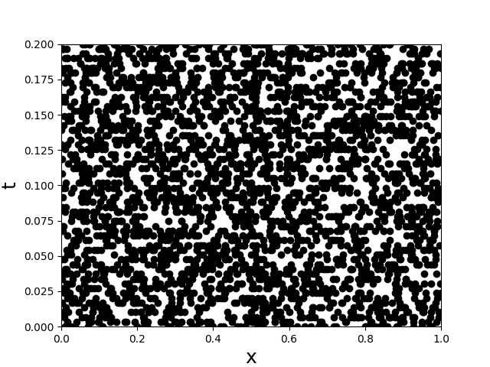
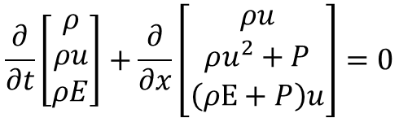
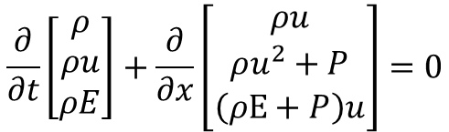
Conventional PINNs and how they work (High Level)
Example 1D Shock Tube
$$\frac{∂}{∂t}\left[\begin{matrix}ρ \\ ρu \\ ρE\end{matrix}\right]+\frac{∂}{∂x}\left[\begin{matrix}ρu \\ ρu^{2}+P \\ \left(ρE+P\right)u\end{matrix}\right]=0$$
Continuous
$$\frac{∂}{∂t}\left[\begin{matrix}ρ \\ ρu \\ ρE\end{matrix}\right]+\frac{∂}{∂x}\left[\begin{matrix}ρu \\ ρu^{2}+P \\ \left(ρE+P\right)u\end{matrix}\right]=0$$
Multi-Layer Perception
Model
Inputs: t, x
Outputs: P, rho, u
PDE Loss
Sampled domain
Optimize Model weights

Slide 8
Conventional PINNs and how they work (Sod Shock tube Problem)
Roe Scheme
Conventional PINNS

Slide 9

What’s the Problem here?
Poor prediction of initial conditions = errors propagate to next time-step
The use of MSE (mean error squared) loss means the Model is tuned to reduce an average error for multiple variables u and v
Possible Solution:
Increase weighting of initial condition
$$L\left(θ\right)={10\left(U\left(θ\right)+V\left(θ\right)\right)}_{ics}+0.1\left[ {\left(U\left(θ\right)+V\left(θ\right)\right)}_{Left}\text{+ }{\left(U\left(θ\right)+V\left(θ\right)\right)}_{Right}\text{+ }{\left(U\left(θ\right)+V\left(θ\right)\right)}_{Top}\text{+ }{\left(U\left(θ\right)+V\left(θ\right)\right)}_{Bottom}+{\left(U\left(θ\right)+V\left(θ\right)\right)}_{Interior}\right]$$
Extend boundary to use more points
Papados, A. Solving Hydrodynamic Shock-Tube Problems Using Weighted Physics-Informed Neural Networks with Domain Extension.
Random Sampling of domain may lead to poorly placed points. Example: Shock Tube discontinuity.

Slide 10
W-PINNs-DE PINNs (Sod Shock tube Problem)
Roe Scheme
W-PINNs-DE¹
https://github.com/alexpapados/Physics-Informed-Deep-Learning-Solid-and-Fluid-Mechanics
¹Papados, A. Solving Hydrodynamic Shock-Tube Problems Using Weighted Physics-Informed Neural Networks with Domain Extension.

Slide 11
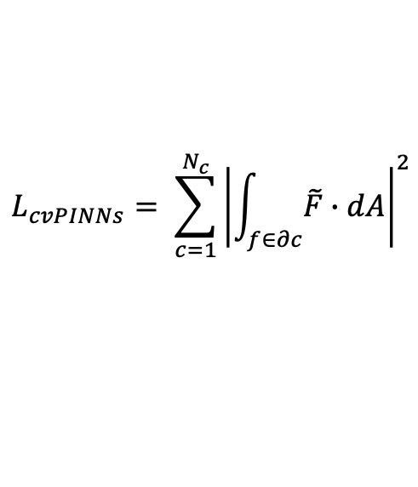

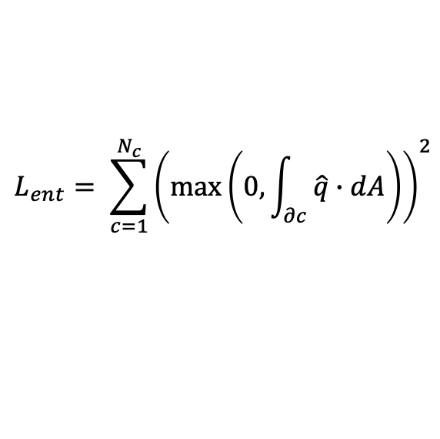
cvPINNs
Conventional PINNs
$$L\left(θ\right)={\left(U\left(θ\right)+V\left(θ\right)\right)}_{ics}+{\left(U\left(θ\right)+V\left(θ\right)\right)}_{Left}\text{+ }{\left(U\left(θ\right)+V\left(θ\right)\right)}_{Right}\text{+ }{\left(U\left(θ\right)+V\left(θ\right)\right)}_{Top}\text{+ }{\left(U\left(θ\right)+V\left(θ\right)\right)}_{Bottom}+{\left(U\left(θ\right)+V\left(θ\right)\right)}_{Interior}$$
Improvements over Conventional
Number of control volumes
1. Modified Loss using Control Volumes
$$L_{cvPINNs}= \sum_{c=1}^{N_{c}}{{\left|\int_{f∈∂c}{\tilde{F}∙dA}\right|}^{2}}$$
2. Artificial Viscosity Penalization
Flux
$$L_{ent}= \sum_{c=1}^{N_{c}}{{\left(\max\left(0,\int_{∂c}{\hat{q}∙dA}\right)\right)}^{2}}$$
3. Entropy Inequality Penalization
3. Total Variation Penalization
https://github.com/rgp62/cvpinns
Patel, R. G., Manickam, I., Trask, N. A., Wood, M. A., Lee, M., Tomas, I., & Cyr, E. C. (2022). Thermodynamically consistent physics-informed neural networks for hyperbolic systems. Journal of Computational Physics, 449, 110754.

